Slide 1
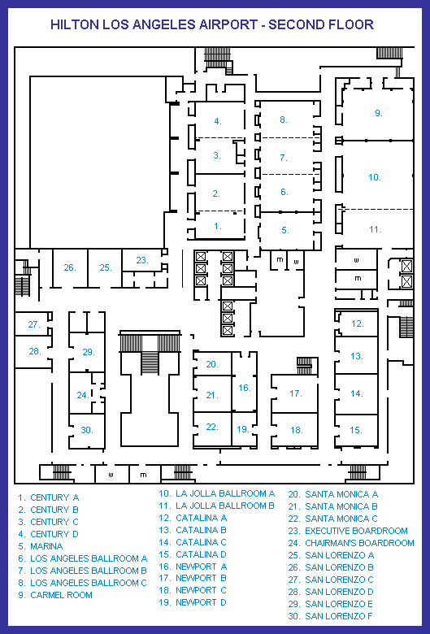

Slide 2
Elevators
Con Registration
Catalina
Newport
First Floor Lobby

Slide 3
Elevators
Event Rooms
3103
3104
3109

Slide 4
Elevators
Event Rooms
3103
3104
3109

Slide 5
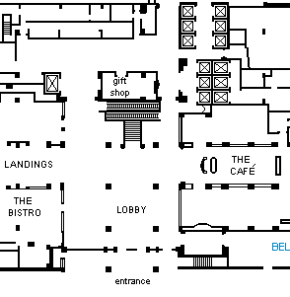
Elevators
Main Stairs
Bel Air Ballroom

